Slide 1
Black Lotus
Rahul Gavhar
Shubham Gupta
Pratik Gupta

Slide 2
What are tokens and what is tokenization?
Tokenization • Tokenization splits text into tokens (words, subwords, characters, or symbols) so models can process language. • Tokens are converted into token IDs (numbers) because ML models operate on numerical data. • Effective tokenization balances efficiency and meaning fewer tokens speed models up while still preserving information.
Challenges • Multilingual text: Languages differ in structure (e.g., English uses spaces, while Devanagari scripts use combining characters). • Unseen or rare words: Tokenizers must split them into reusable subwords instead of producing too many [UNK] tokens.

Slide 3
Task 3: Comparison of tokens
EN transliteration :
Jana Gana Mana Adhinayaka Jaya He
Bharata Bhagya Vidhata
Punjab Sindhu Gujarat Maratha
Dravida Utkala Banga
Devanagri :
जन गण मन अधिनायक जय हे
भारत भाग्य विधाता
पंजाब सिंधु गुजरात मराठा
द्राविड़ उत्कल बंग
script | Tokens | Words | Fertility
English Transliteration | 317 | 55 | 5.763
Devanagari | 227 | 55 | 4.203

Slide 4
Task 16
Task 17 and 18
What I found (Confidence Signals)
Deterministic behavior and artifact discipline:
Seeded training behavior is validated in tests.
Artifacts include schema version checks and checksum metadata.
Strong error model:
Typed custom exceptions make failures observable and debuggable.
Config validation (Pydantic) catches setup issues early.
Good multilingual design choices:
Devanagari-safe normalization defaults (NFC strategy).
Streaming-style corpus handling avoids loading entire datasets in memory.
What We Did
Task 17: Fixed a CLI bug where --min-freq was accepted but ignored in inline training mode.
Task 18: Explained why this minimal fix was chosen instead of a larger refactor.
Task 16: Not attempted.
Problem (Task 17)
In inline mode (--corpus --model --output), the CLI built a frozen Pydantic TokenizerConfig.
The code tried to mutate tok_config.trainer.min_frequency directly.
Because configs are immutable, the override was ignored.
Result: Trainer continued using the default min_frequency.
Fix Implemented
File: src/abctokz/cli/train.py
Replaced in-place mutation with Pydantic immutable update using:
tok_config = tok_config.model_copy(update={...})
Applied only for trainers that support min_frequency:
WordLevel
BPE
Why This Approach (Task 18)
Minimal change – only CLI wiring modified.
Low risk – no changes to trainer algorithms.
High impact – CLI flag now behaves as expected.
YAML config mode remains unchanged.
What We Avoided
No large CLI refactor
No trainer logic changes
No config system redesign

Slide 5
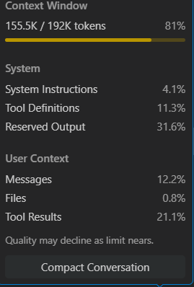
List up to 5 things that you did not understand about the codebase
• Understand training internals of WordLevel, BPE, and Unigram to see exactly why tokens are added, kept, or dropped.
• Analyze how pretokenizers handle mixed scripts (Latin, Devanagari, punctuation) and detect inconsistent splits.
• Compare Hugging Face and SentencePiece adapters with the native implementation to find token/decoding differences.
• Verify whether the offset mapping after pretokenization correctly points to original text spans.
• Check training determinism by identifying steps that could introduce randomness across runs.
TOKENS USED : 155.5 K
THESE ARE THE OVERALL TOKENS OF ALL MEMBERS

